Slide 1

OPENING SCHOOL LITURGY 2023
CATHOLIC EDUCATION SANDHURST LTD
“Let the words you speak always be full of grace”

Slide 2
Welcome to the opening school liturgy for 2023
This year’s theme for Sandhurst schools is
“Let the words you speak always be full of grace.”
As we continue to spread the Good News, we are called to be people of dialogue, using our words as instruments of love.
Let us listen to St Paul’s letter to the Colossians and the words of Pope Francis to understand better our 2023 theme.

Slide 3
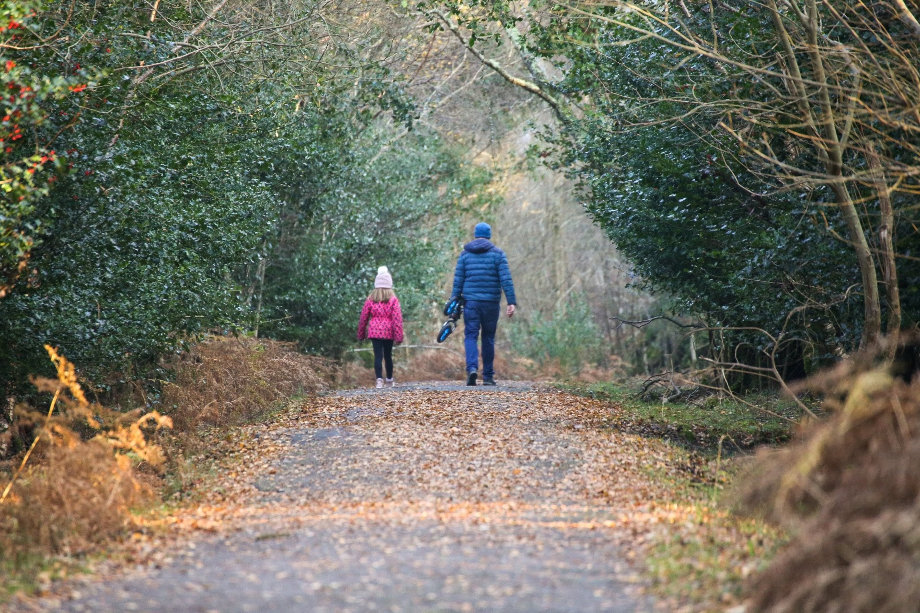
A Reading from Paul to the Colossians (4:6)
Devote yourselves to prayer, being watchful and thankful. And pray for us, too, that God may open a door for our message so that we may proclaim the mystery of Christ, for which I am in chains. Pray that I may proclaim it clearly, as I should.

Slide 4
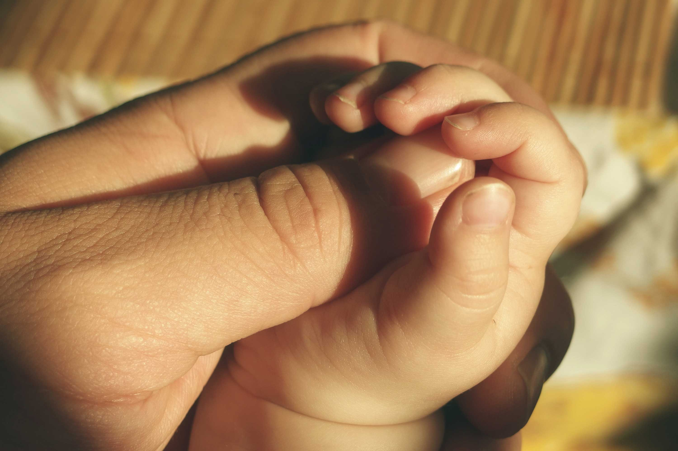
Be wise in the way you act toward outsiders; make the most of every opportunity. Let your conversation always be full of grace, seasoned with salt, so that you may know how to answer everyone.
The Word of the Lord
Thanks Be to God

Slide 5
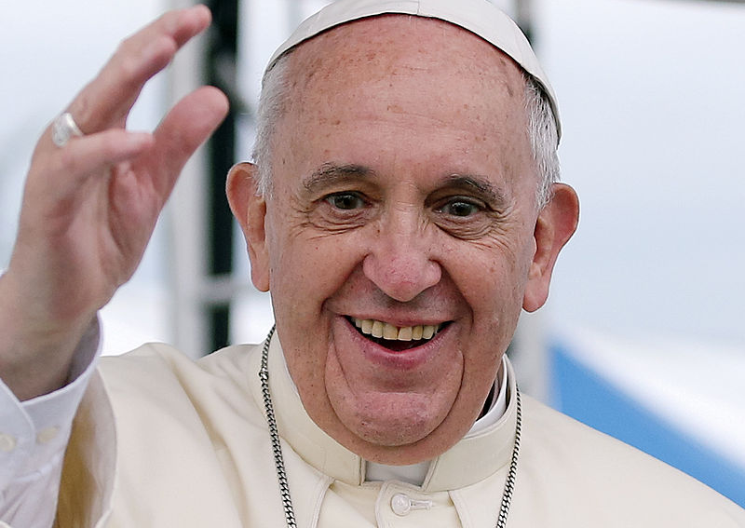
A REFLECTION FROM POPE FRANCIS
To let your speech be full of grace and seasoned with salt is to speak the truth in love by being mindful that words have the power to break or connect communities. "If there is one word that we should never tire of repeating, it is this: dialogue. We are called to promote a culture of dialogue by every possible means and thus to rebuild the fabric of society.” Pope Francis- Address upon receiving the Charlemagne Prize, May 6, 2016
In 2023 “Let the words you speak always be full of grace.”

Slide 6
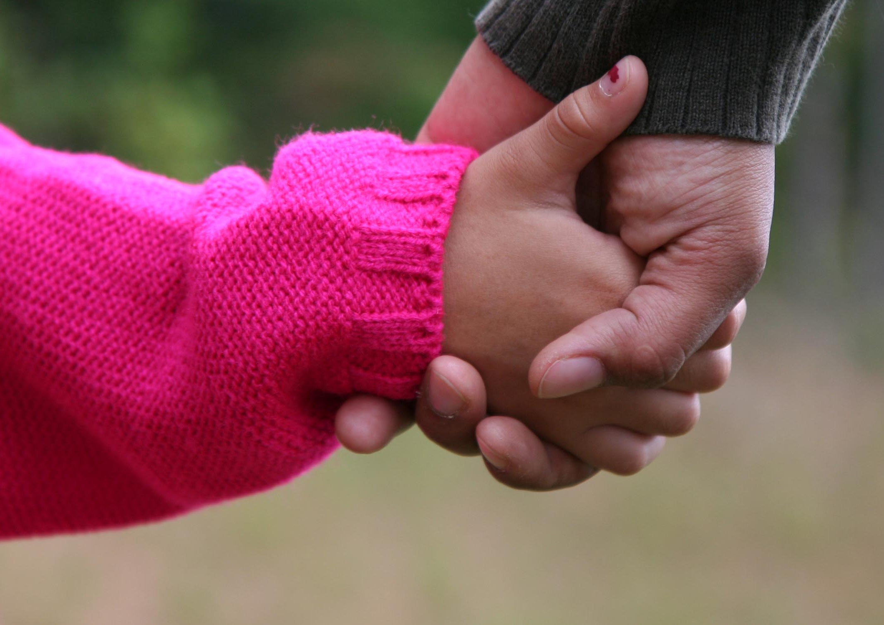
A REFLECTION FOR OUR CHILDREN
As we begin our new school year, we are reassured of God's presence every day.
God lives in the hearts of our staff and students, inviting us to be God’s eyes, ears and voice.
May we accept the gift and speak God’s words to others.
May we also accept the gift of listening to others who speak God’s words to us.
Listening and speaking is called ‘dialogue.’
We grow as people of faith, hope and love when we share dialogue.
In 2023 “Let the words you speak always be full of grace.”

Slide 7
Prayers of the Faithful
For our world. That through healthy dialogue, our leaders light up the world as beacons of hope
Lord, Hear Us. Lord, Hear Our Prayer
For the church. That through dialogue with all world religions, we grow as Christ-filled people of love, faithful to the Gospel.
Lord, Hear Us. Lord, Hear Our Prayer
For our school community. That as we dialogue with one another, we grow to become the best people we can be
Lord, Hear Us. Lord, Hear Our Prayer
For our personal intercessions………
Lord, Hear Us. Lord, Hear Our Prayer

Slide 8
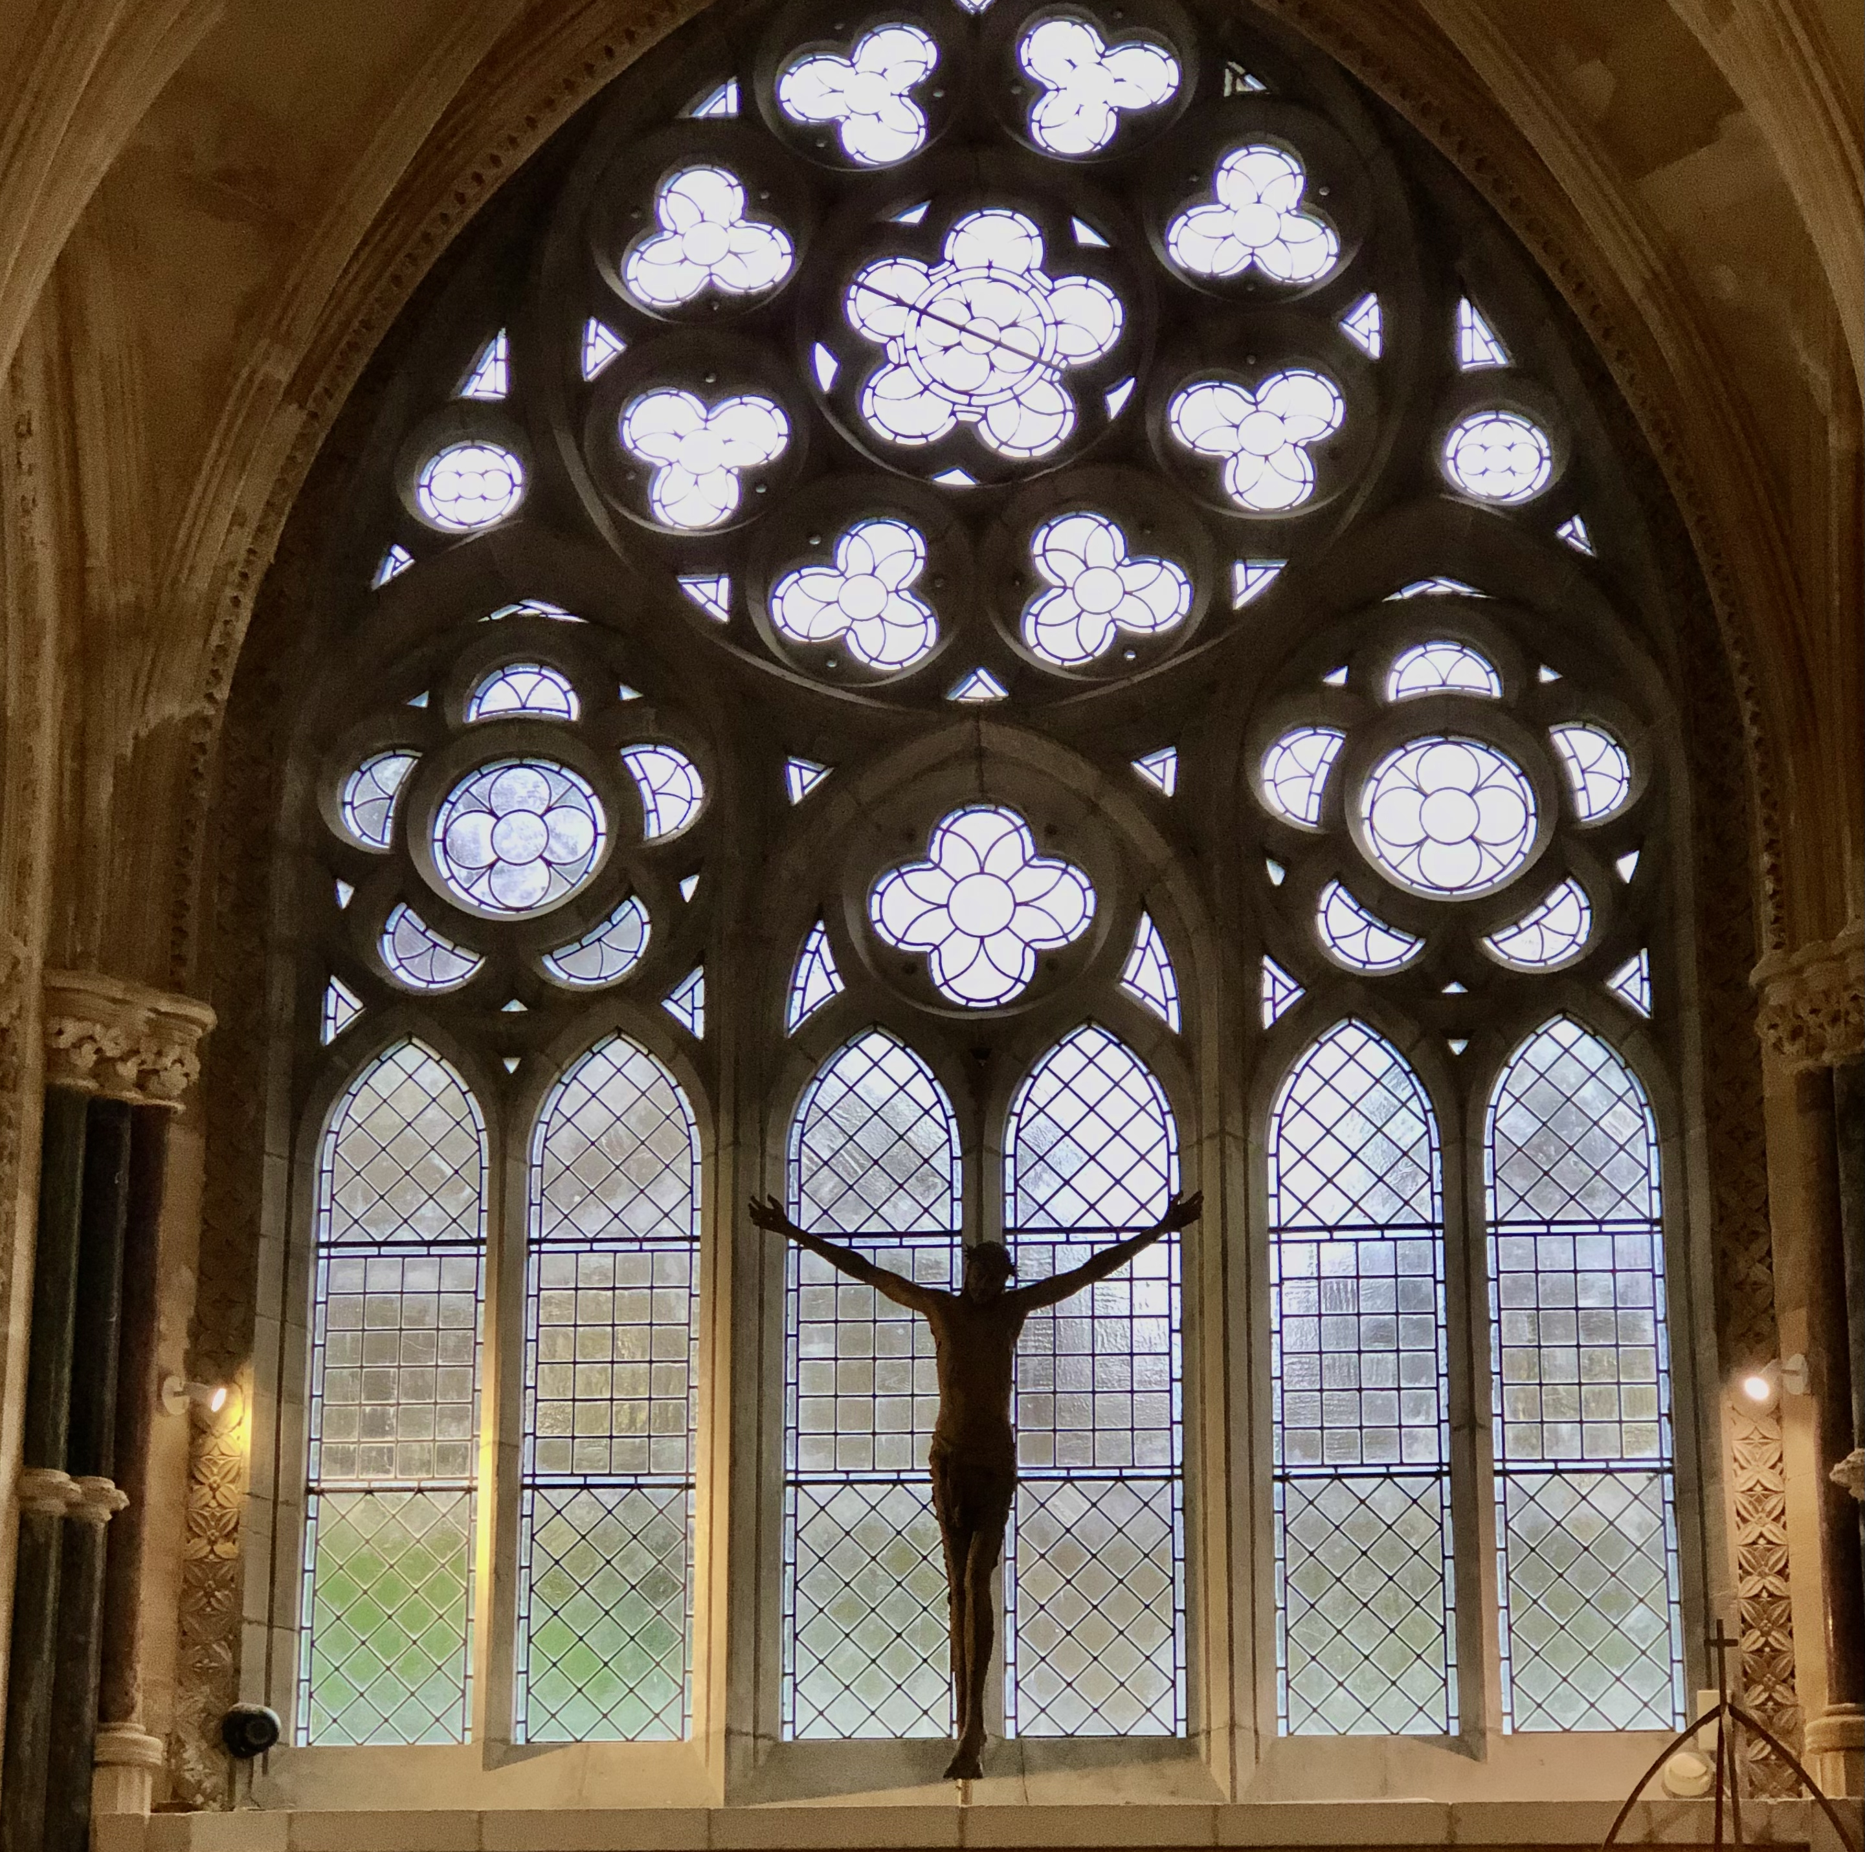
Concluding Prayer
Lord, may I use the gift of listening to hear your voice in others
May I use the gift of my voice to speak your words to others
May I use the gift of my life to share your love with others
Amen

Slide 9

1.Open my eyes, Lord
Help me to see Your face
Open my eyes, Lord
Help me to see
2.Open my ears, Lord
Help me to hear Your voice
Open my ears, Lord
Help me to heart
3.Open my heart, Lord
Help me to love like You
Open my heart, Lord
Help me to love
4.I live within You
Deep in Your heart, oh love
I live within You
Rest now in me
Songwriters: Jesse Manibusan Open My Eyes lyrics © Spiritandsongcom Publishing

