Slide 1

Catholic Education Sandhurst Ltd
Opening School Liturgy 2022
‘Go out to all the world and
tell the Good News to all creation’
(Mark 16)

Slide 2
Acknowledgement of Country
We acknowledge the traditional owners and custodians
of all the lands across our Sandhurst schools
We pay our respect to elders, past, present and future.
They hold the story, hope and dreaming for all.
We affirm the wisdom of this ancient culture.
It reminds us that God’s Word is part of the whole of creation.
This message celebrates reconciliation with God, creation and all people.
May we continue to walk the message of
love, joy, peace and reconciliation.

Slide 3
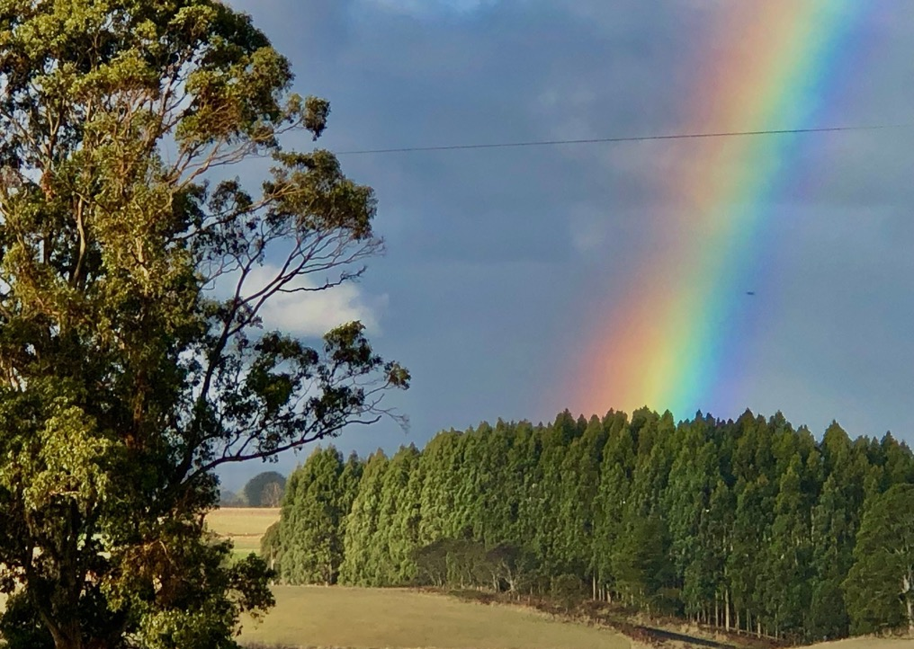
Preparing Our Hearts
Taking a moment to become still,
listening to our bodies, minds and hearts,
listening to the breath we breathe in and the breath we breathe out.
God is with us.

Slide 4
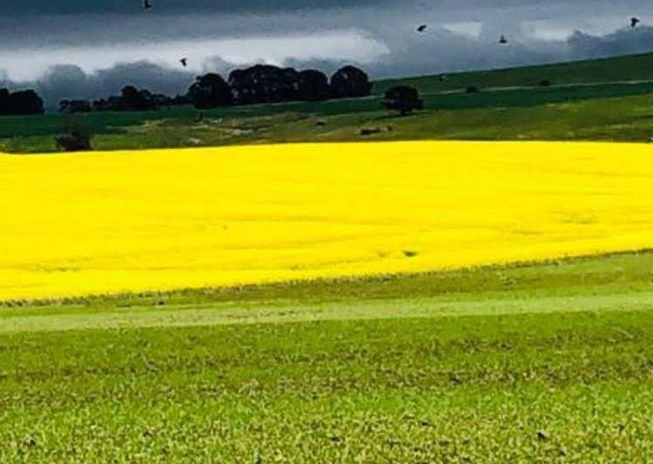
Preparing Our Hearts
Become aware of the gift of life
God gives today,
Become aware of the difference you have made in our world today,
Become aware of your needs and how you feel today.
God is with us. (pause)
Sign of the Cross:
In the name of the Father, Son and Holy Spirit, Amen

Slide 5
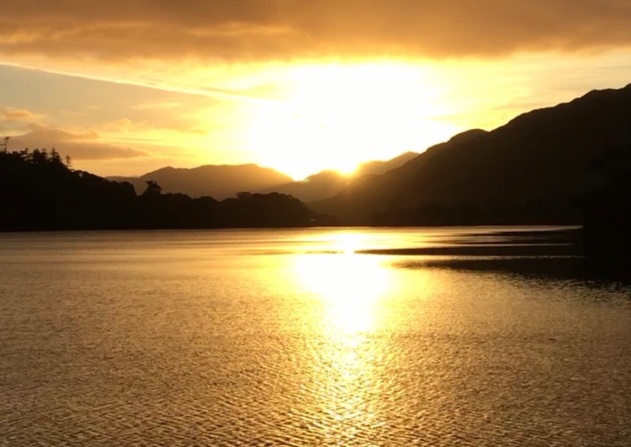
Contemplating God Through Art
Leader:
Spend some time looking at this image and ask yourself:
What do you notice about this image?
How does this image symbolize your life today?

Slide 6
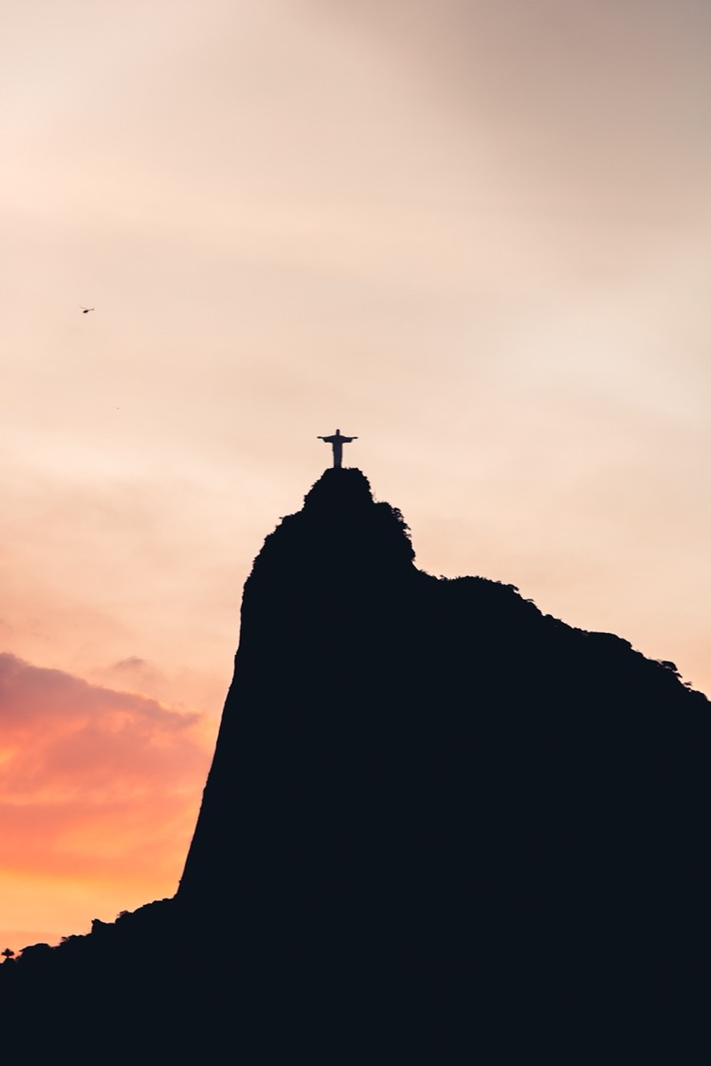
Reflecting upon the Word
A Reading from Mark’s Gospel
Abridged Version
After rising from the dead, Jesus appeared to eleven of his disciples and said to them, “Go into all the world. Preach the good news to everyone. Anyone who believes and is baptized will be saved. But anyone who does not believe will be punished. Here are the miraculous signs that those who believe will do. In my name they will drive out demons.

Slide 7
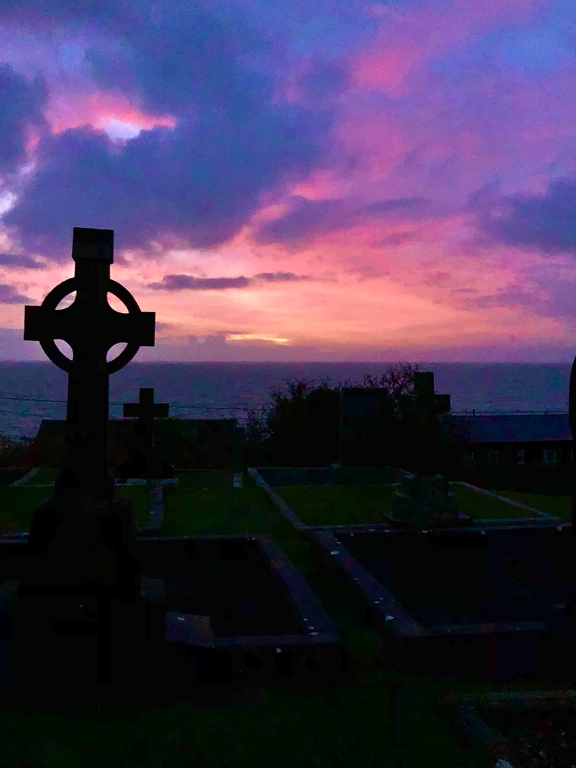
Reflecting upon the Word
They will speak in languages they had not known before. They will pick up snakes with their hands. And when they drink deadly poison, it will not hurt them at all. They will place their hands on sick people. And the people will get well.”

Slide 8
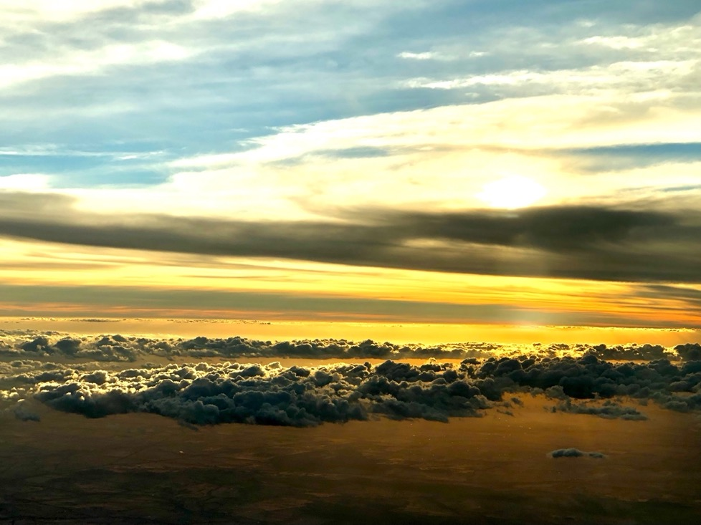
Reflecting upon the Word
When the Lord Jesus finished speaking to them, he was taken up into heaven. He sat down at the right hand of God. Then the disciples went out and preached everywhere. The Lord worked with them. And he backed up his word by the signs that went with it
The Gospel of the Lord
Praise to you Lord Jesus Christ

Slide 9
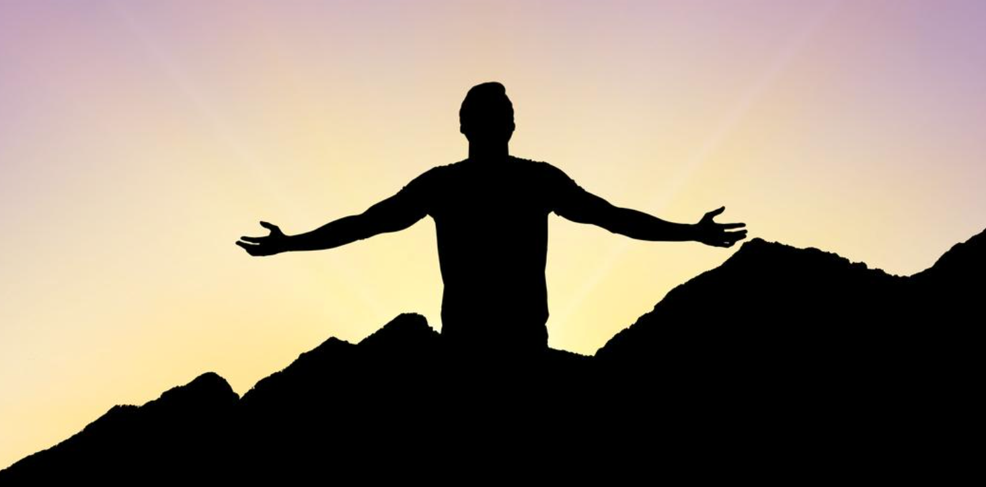
TELL THE GOOD NEWS!
Our official theme for 2022 in Sandhurst
Catholic Education
Schools

Slide 10
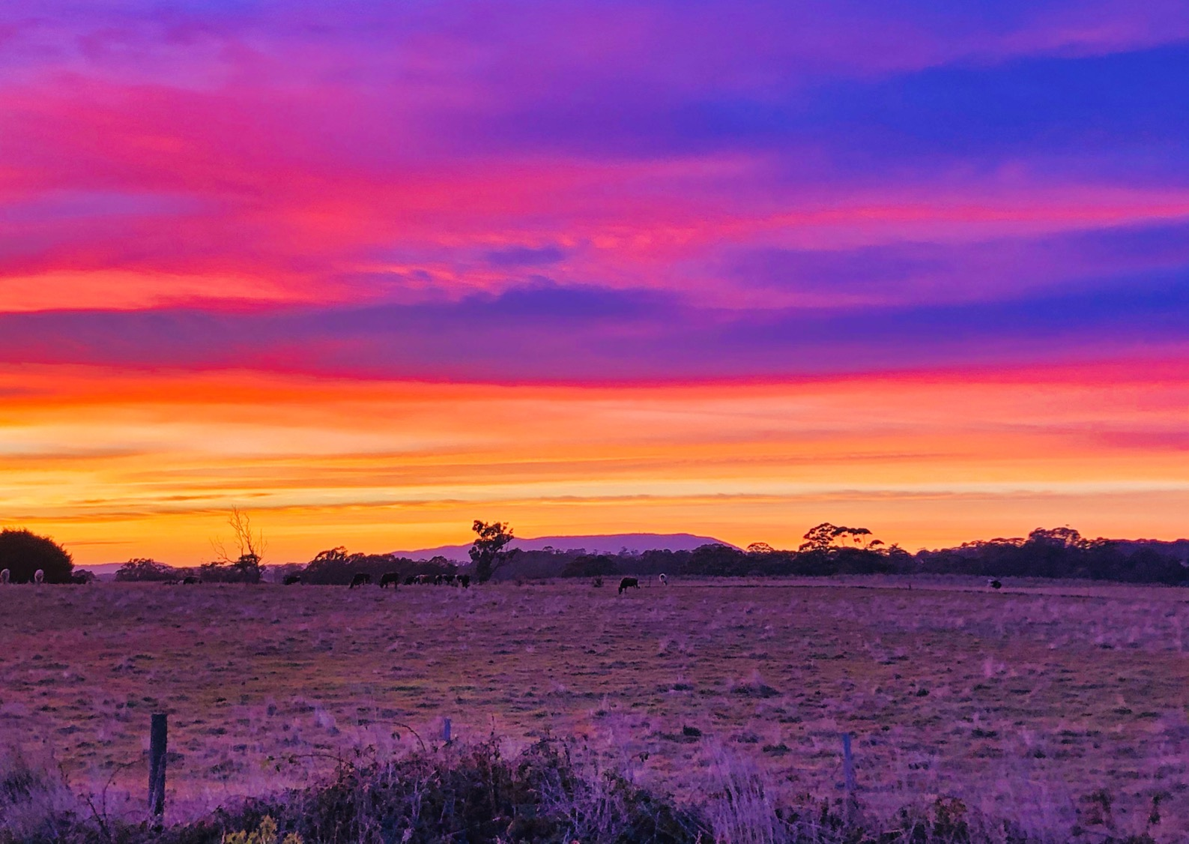
What is the Good News?
God loves us all unconditionally, the rich, the poor, creation, especially the marginalised.
In fact, God loves us so much that he became human in the form of Jesus. Through Jesus’ life, death and resurrection, God put an end to sin forever, promising us everlasting life in Christ.

Slide 11
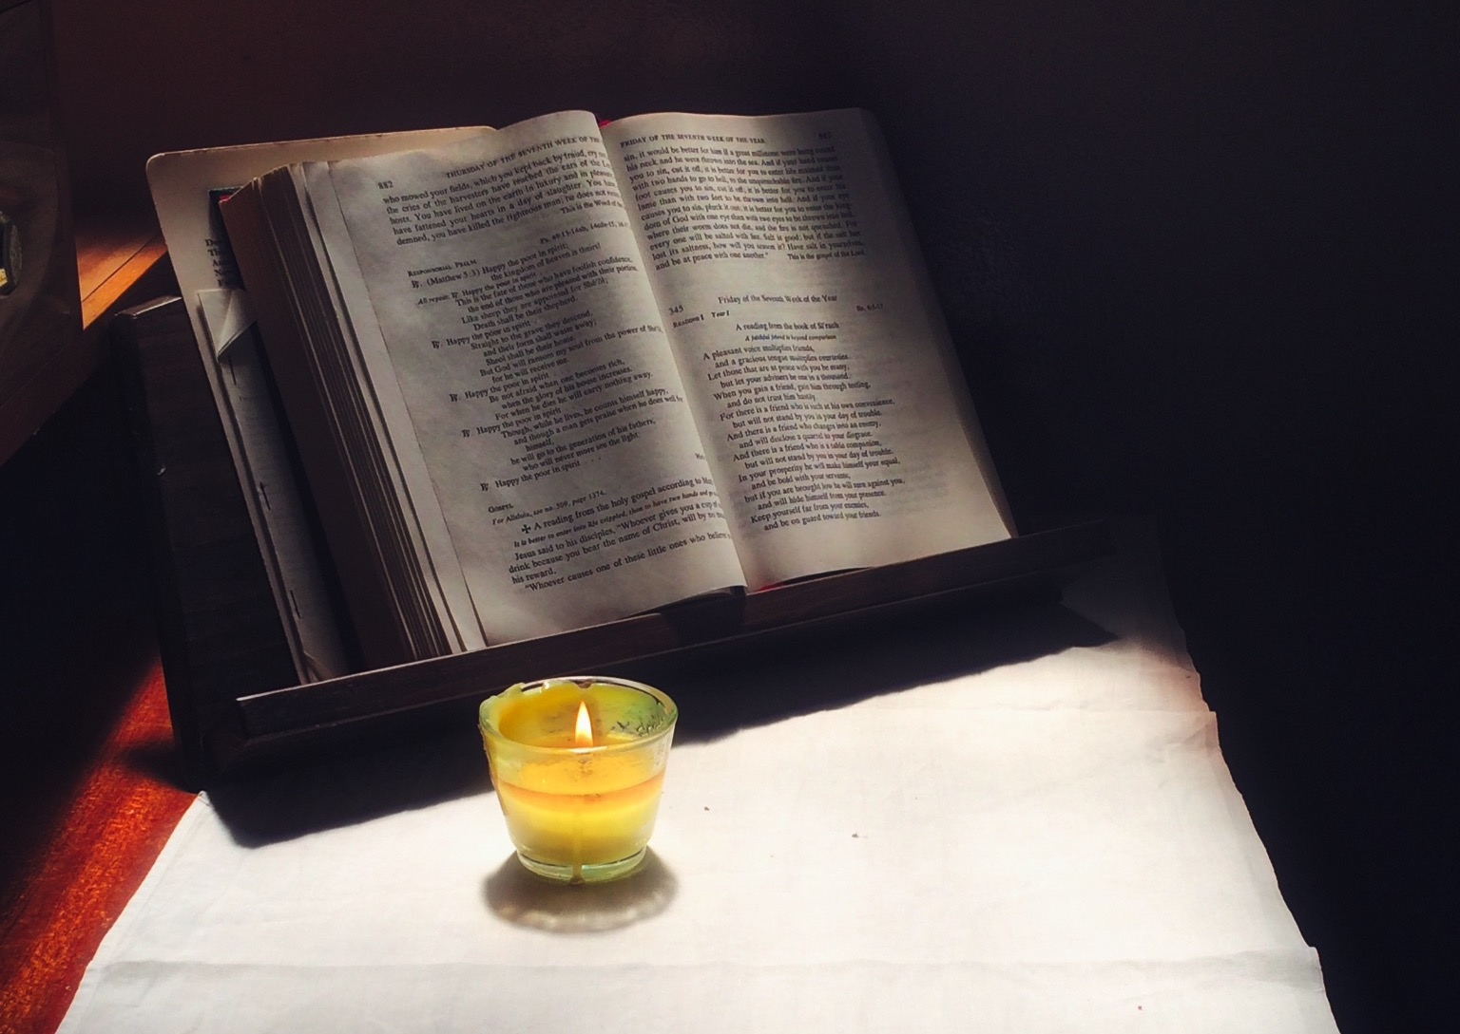
The word Gospel means ‘good news’.
And just like Jesus,’ we are called to go out and tell the good news, to be ‘Jesus in the world’ by our loving actions

Slide 12
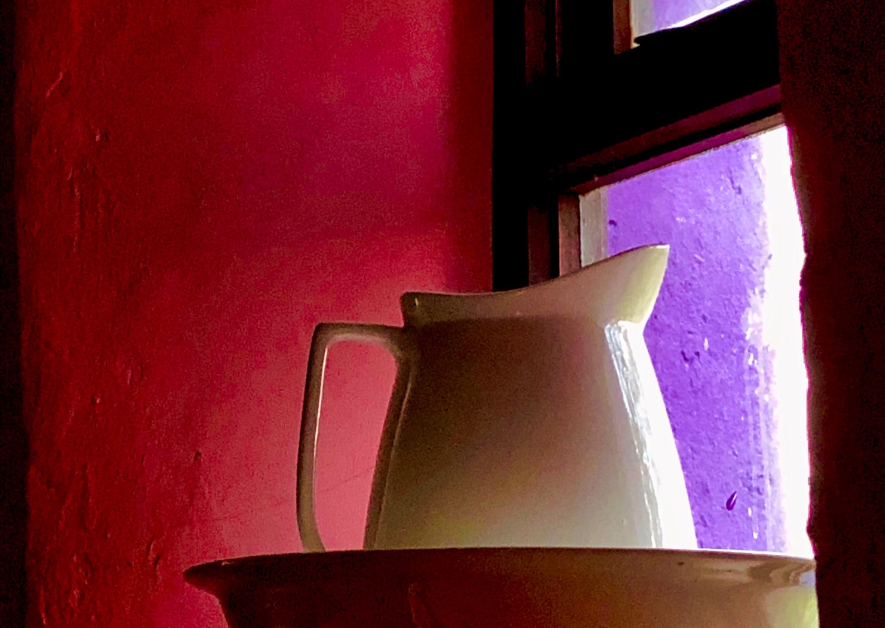
Reflection:
What acts of love did Jesus demonstrate in his life, ministry?
How can I be ‘Jesus in the world’ by my actions?

Slide 13
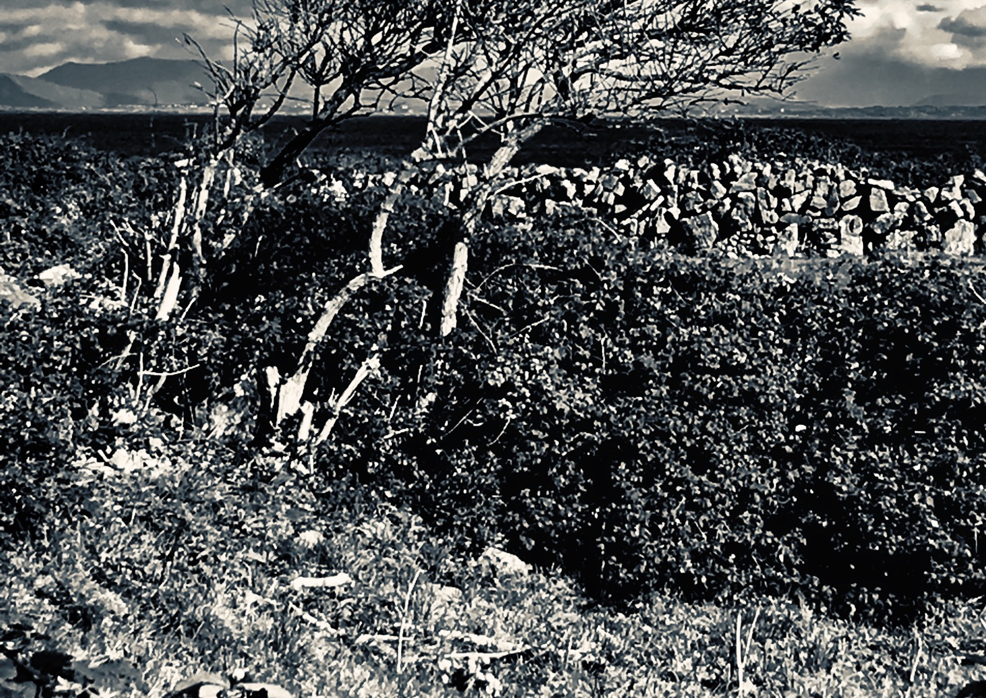
Like the people of the Old Testament, the new Testament and even today, we struggle to be people of love all the time.
Before we can tell the Good News of God’s love for everyone, we must know it personally and let go of our selfish ways.
We cannot be love to other people if we only focus upon us our selves.

Slide 14
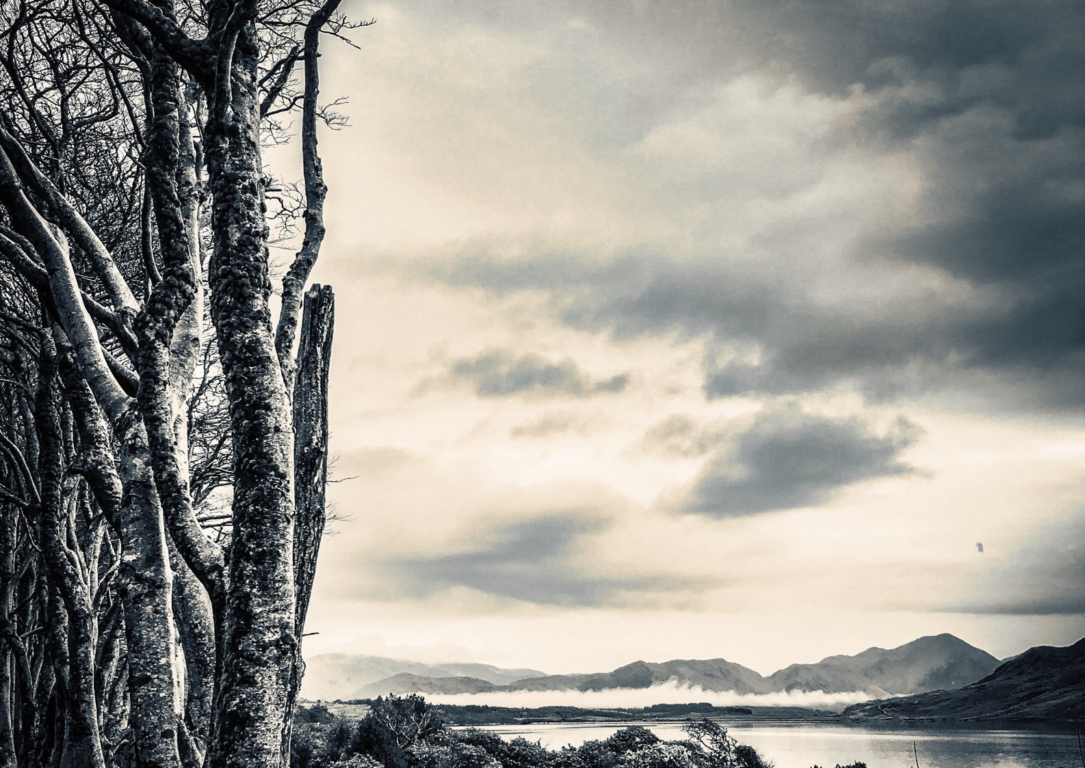
By suffering dying and rising, Jesus showed us a new way of living.
We acknowledge that we suffer by our selfish ways, we let go of our old ways, dying to them and rising to a new loving way of living. This is really Good News!

Slide 15
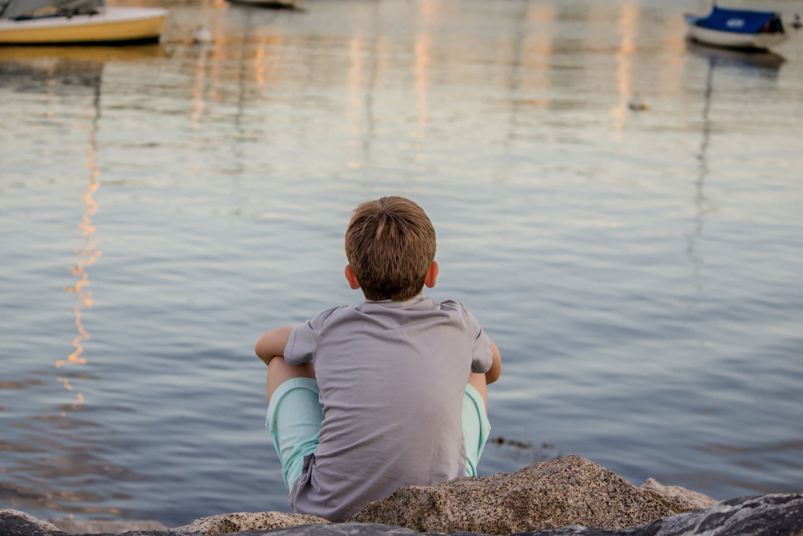
Reflection
What stops you from being your true self?
What are you willing to let go of?
What might your new life look like?

Slide 16
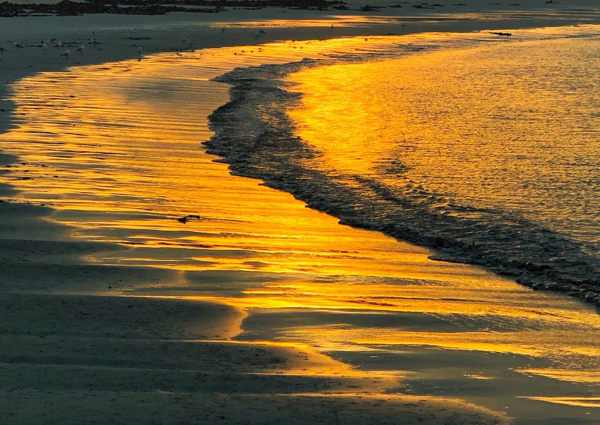
Like his disciples, Jesus knew that we would not cope well on our own, so he sent a helper, the Holy Spirit.
God wants us to use our God given gifts to make a difference in our world, caring for creation, answering the cry of the poor.

Slide 17
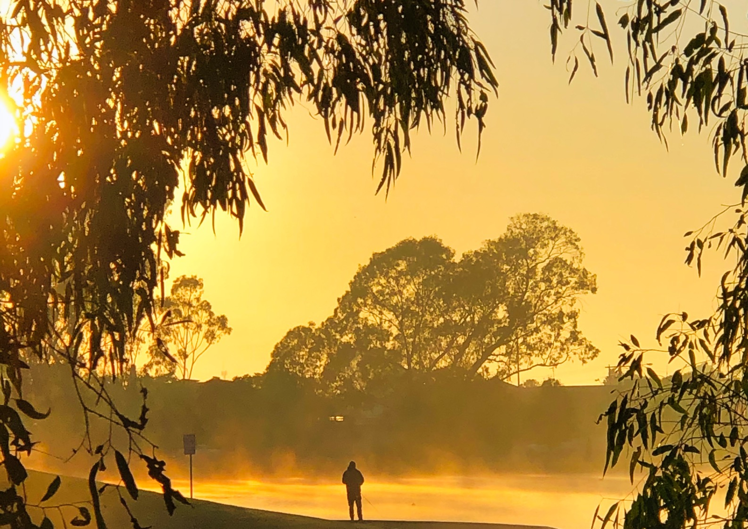
REFLECTION:
Can you remember a time when you felt supported by the gifts of the Holy Spirit?
Perhaps God gave you courage, inspiration.
What God given gifts and talents have you received from God?
How can you use your gifts to tell the Good News?

Slide 18
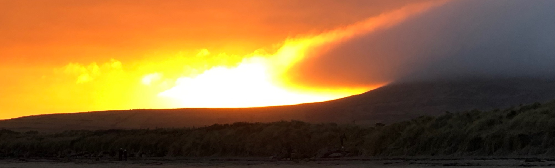
Living a life in union with a God that loves us so much,
Knowing that we are never alone
Listening to God and being people of service and love, to the poor, creation, the marginalised
The promise of an eternal life united in Christ
Now that is Good News!!

Slide 19
Prayers of the Faithful
For our world. That our leaders light up the world as beacons of hope to their communities
Lord Hear Us. Lord Hear Our Prayer
For the church. That we remain faithful to the Good News of the Gospel, sharing Christ’s message of love for all of creation.
Lord Hear Us. Lord Hear Our Prayer
For our school community. That we use our God given gifts to become the best person we can be as we live out the ‘Good News’
Lord Hear Us. Lord Hear Our Prayer
For our personal intercessions………
Lord Hear Us. Lord Hear Our Prayer

Slide 20
Concluding Prayer
“Christians have the duty to proclaim the Gospel … to share their joy, who point to a horizon of beauty and who invite others to a delicious banquet … The Samaritan woman became a missionary immediately after speaking with Jesus and many Samaritans come to believe in him “because of the woman’s testimony”. So too, St Paul, after his encounter with Jesus Christ, “immediately proclaimed Jesus” . So, what are we waiting for?”
Pope Francis
Loving God,
Help us to be an instruments of Your love
Bringing the Good News to all we meet
Sharing the Good News of the Gospel
Being the Good News with our lives
We make this prayer through Christ our Lord
Amen

